Slide 1
Interpreter pattern
Emrullah SONTEKIN 11.05.2010

Slide 2
What is Interpreter?
a person who interprets foreign speech orally.
( Computing) a program that can analyse and execute a program line by line.
(Oxford University Press, 2004)

Slide 3
Motivation
How to evaluate sentences in a language?
Published in the GoF(Gang of Four) which is not really used.
Terms of formal grammars

Slide 4
Intent
Given a language, define a representation for its grammar along with an interpreter that uses the representation to interpret sentences in the language
Map a domain to a language, the language to a grammar, and the grammar to a hierarchical object-oriented design

Slide 5
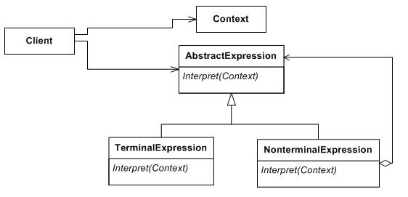
Implementation
just the use of the composite pattern applied to represent a grammar

Slide 6
Implementation
Difference : The Interpreter defines the behaviour while the composite defines only the structure.

Slide 7
Applicability & Examples
Exaustively in defining grammars, tokenize input and store it.
A specific area where Interpreter can be used are the rules engines.
The Interpreter pattern can be used to add functionality to the composite pattern

Slide 8
Examples
Reverse Polish notation
Roman Numerals Convertor

Slide 9
Conclusion
Limited area where Interpreter pattern can be applied
This pattern can be applied for parssing light expressions defined in simple grammars and sometimes in simple rule engines.

Slide 10
References
http://en.wikipedia.org/wiki/Interpreter_pattern
http://www.oodesign.com/interpreter-pattern.html
http://www.dofactory.com/Patterns/PatternInterpreter.aspx#participants

Slide 11

Thank YOU!!!

